Slide 1
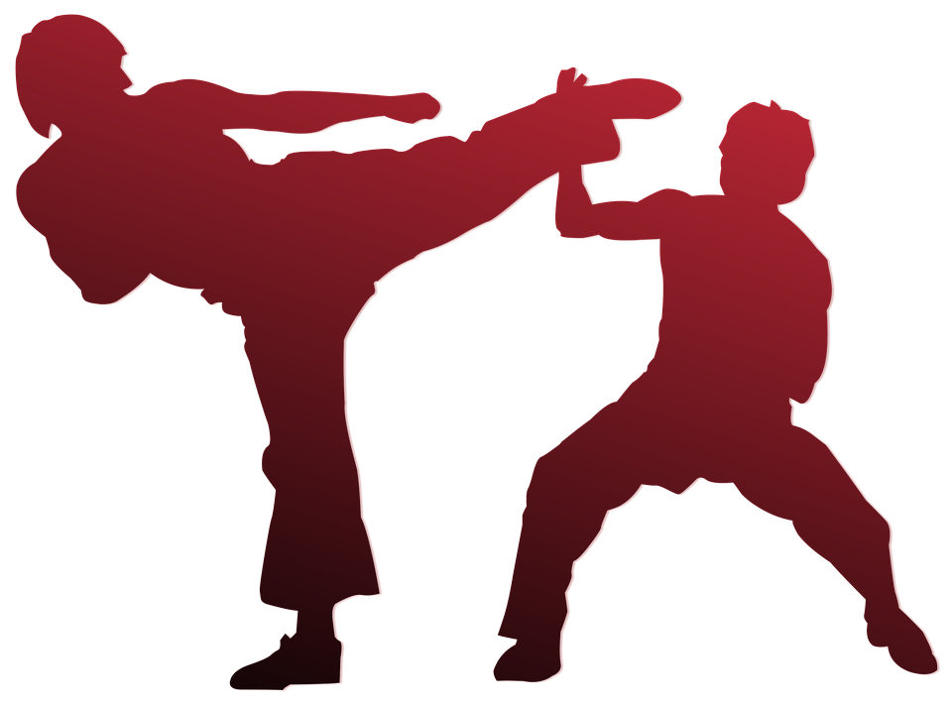
Karate
Martial Arts
Notes:
M.K.G.N.N.Jayamani
23.2
Faculy Of Computing

Slide 2
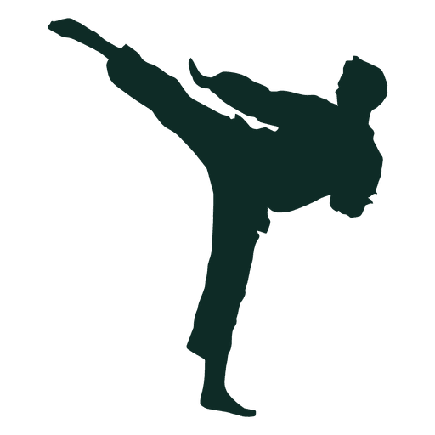
What is Karate?
Karate is a Japanese martial art. What is the word “Karate” origin? “Kara” means “empty,” and “te” means “hand.” Together, the term “karate” refers to the art of fighting hand to hand without weapons.

Slide 3
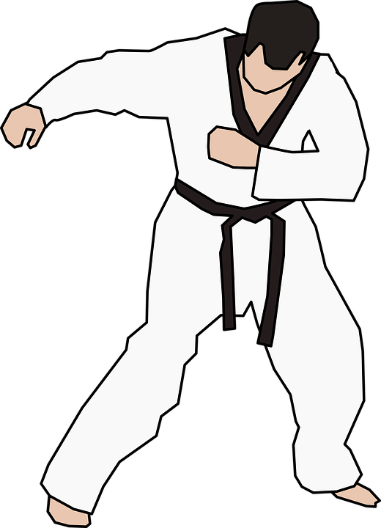
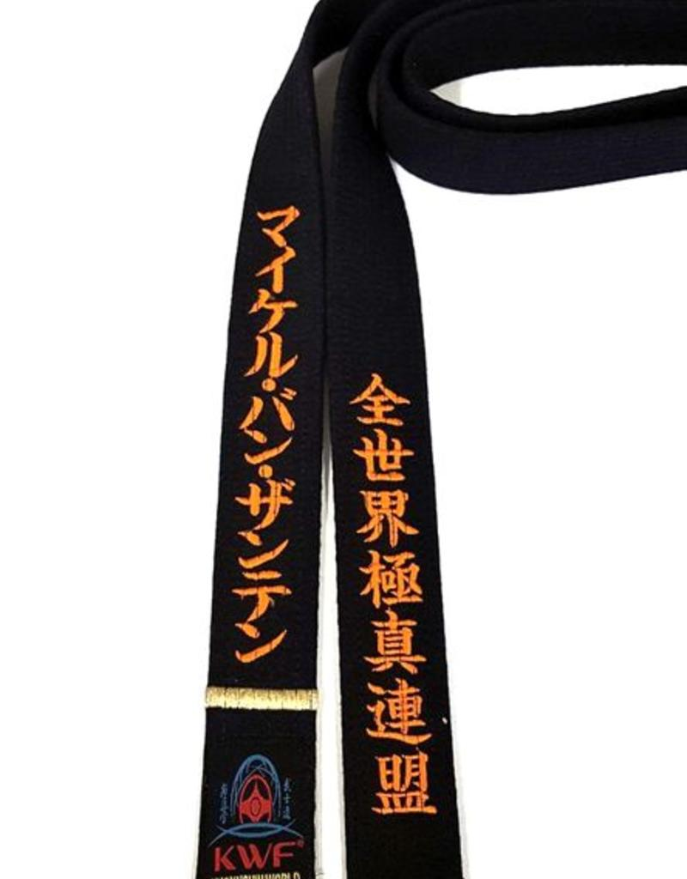
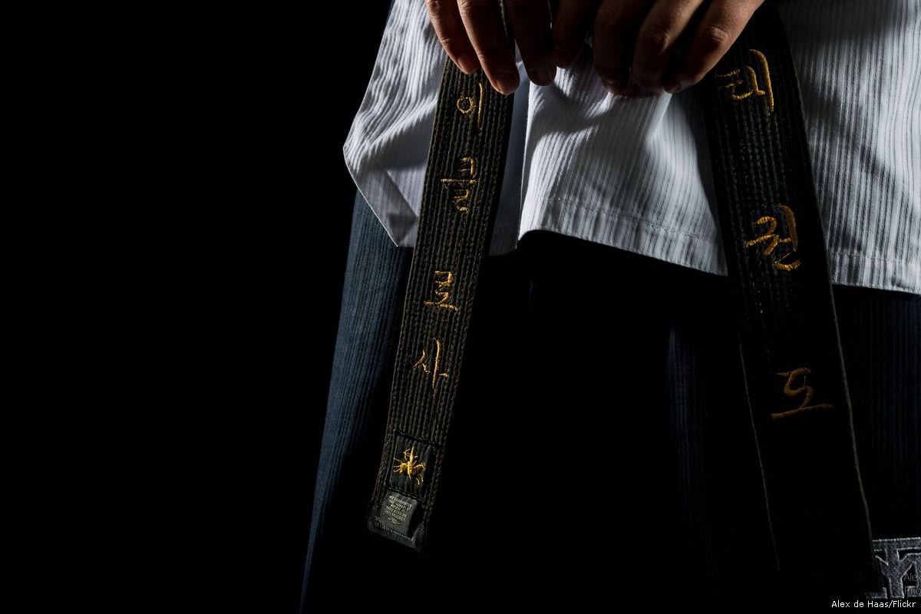
Origins of Karate
Where does karate come from?
Like many Asian martial arts, karate’s origins are ancient but karate as it is known and practiced today is fairly recent. Karate can be traced back to the island of Okinawa, where inhabitants developed a closed-fist system of fighting called “te.”
Some accounts say Okinawa sent a few of its young men to China to learn martial arts techniques from Shaolin monks. Others credit the opening of trade routes through Okinawa circa 1372 with bringing Chinese visitors to the island who introduced their martial arts techniques to Okinawans.
Either way, the result was a heavy Chinese influence on the Okinawan martial art.Because Japan banned weapons in Okinawa in 1609, empty-hand fighting techniques continued to be practiced and refined. These techniques became the basis for modern karate.
Over the years, three cities in Okinawa – Shuri, Tomari, and Naha – took a prominent role in developing styles of te, with each style named after its city of origin. Collectively, these styles were referred to as, “Okinawa-Te,” a style of martial art that is still widely practiced today.

Slide 4
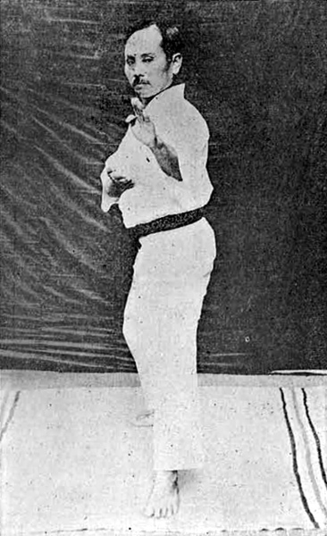
Karate in Japan
Karate was first introduced to Japan in 1917 by Gichin Funakoshi, the founder of modern karate. Funakoshi’s demonstration impressed the public and Crown-Prince Hirohito, who expressed enthusiasm for the martial art.
Five years later, the founder of the Japanese martial art of Judo, Dr. Jano Kano, invited Funakoshi to demonstrate karate at his dojo and then to stay and teach. Because karate had been previously viewed as a “peasant” martial art, Dr. Kano’s backing was instrumental in the acceptance of karate and its establishment in Japan.
Today there are four main styles of karate practiced in Japan, all of which were founded between 1928 and 1939: Wado-ryu, Goju-ryu, Shito-ryu, and Shotokan. All use the same basic principles but each style has a different emphasis of technique.

Slide 5
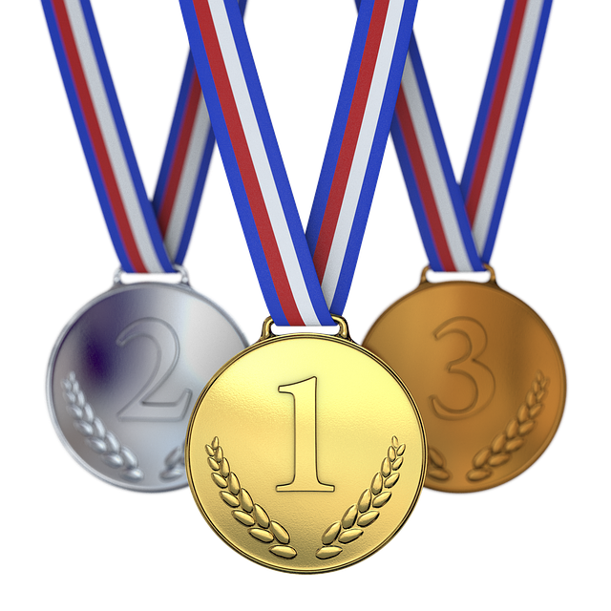
Origins of Karate in the US
Again, like most Asian martial arts, karate came to the US through its introduction to the military. Karate’s journey to the US began in 1942 with a chance meeting between Robert A. Trias, who was then serving in the South Pacific in the US Navy, and T’ung Gee Hsing, a karate master. Trias was training for a middleweight boxing championship and Hsing, who was fascinated by American boxing, convinced Trias to spar with him. The result was Hsing giving Trias, “the biggest thrashing of my life.” Trias asked Hsing to teach him and subsequently earned his black belt in 1943.
In 1946, Trias opened the first karate school in the US and two years later, founded the United States Karate Association – now the largest karate organization in the world.
Throughout the 1960s and ’70s, many individuals brought their own take on karate to the US, opening schools all over the country. During this time, many other martial arts were being introduced in the US including taekwondo, judo, aikido, and various styles of karate.
Because of this proliferation of martial arts and karate styles, it’s not surprising the word “karate” has become somewhat of a catch all term for martial arts in the United States. However, referring to all martial arts as “karate” isn’t accurate or appropriate. While Japanese, Chinese, and Korean martial arts are all closely related and interwoven, each has a different history, culture, and background expressed through different techniques and philosophies.

Slide 6
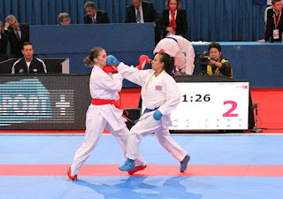
Basic Principles and Techniques
Karate techniques focus mainly on hand strikes, but uses elbow and knee strikes as well as some kicking techniques.
Students practice two modalities of karate: kata, a series of attack and defense techniques used against an imaginary opponent, and kumite, sparring against an opponent using attack and defense techniques.
The philosophy of karate emphasizes proper training of the mind as well as the body, building character, and focusing on principles such as respect, self-control, and concentration.

Slide 7
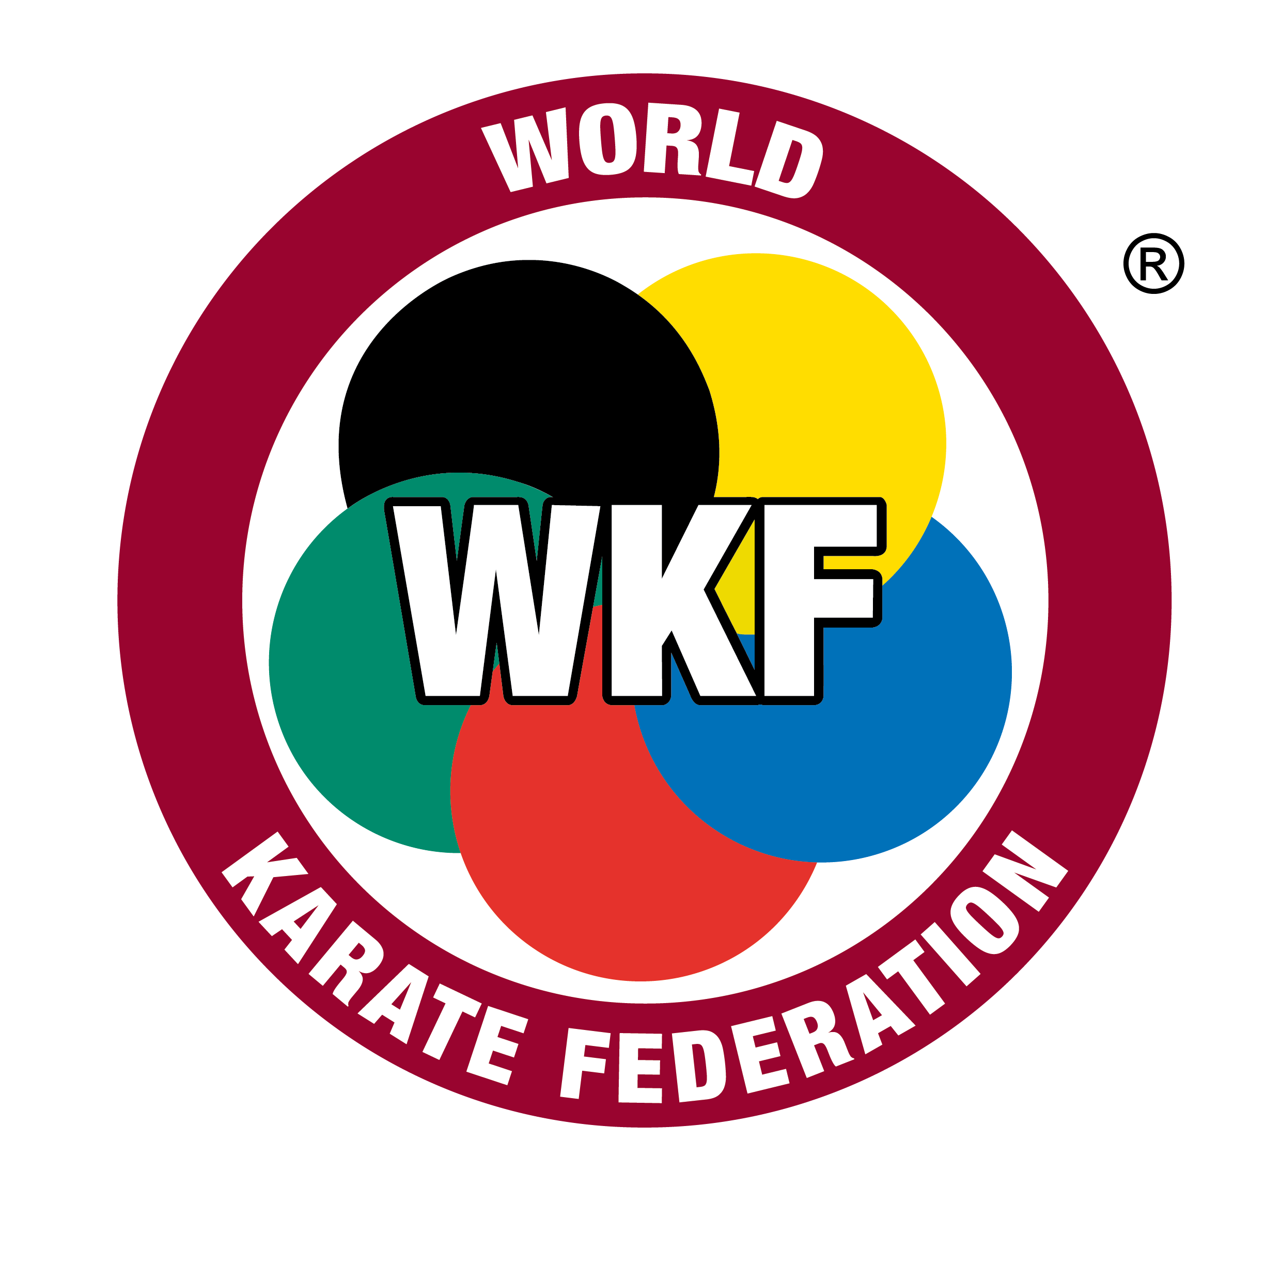
Why Karate
Practicing karate provides many physical benefits including improved physical conditioning and coordination. It also provides self-confidence from learning self-defense techniques along with developing self-discipline and improved focus.
Because of the volume of schools and instructors teaching so many different karate styles, there is sure to be a school and philosophy that’s a good fit for you and/or your family.
For those who wish to practice karate competitively, the martial art has joined the list of Olympic sports and will make its debut at the 2020 Tokyo Olympics. All styles of karate are welcome, as long as the athlete is a member of the World Karate Federation.
This Photo by Unknown Author is licensed under CC BY-SA

Slide 8
Equipment Of Karate
A white uniform called a gi is required. For sparring and during competition, safety equipment is used including protection for the head, hands, chest, shins, and feet. (Mouth guards for all students, and groin cups for males, are strongly recommended.)
Though karate is by definition a empty-hand martial art, techniques with a wide variety of weapons such as the bo staff, sword, chain whip, fan, and many others are also studied.
Karate is a martial art meant to be studied for the long haul. For those willing to take the journey, the benefits gained physically and mentally are well worth it.
About the author: Holly Layman is a writer based in Southern California. She holds a first degree black belt in taekwondo.
To learn more about the history and practice of martial arts check out the other articles in the Puncher “What is” series on Judo, Boxing, Karate, Taekwondo, Muay Thai, Sambo, MMA and more.

Slide 9
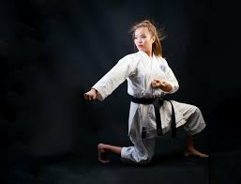
Different Types Of Kicks
According to the Karate sport there are different types of kicks....
Ex: Front kick with thrust (Mae-geri kekomi).
Side kick with thrust (Yoko-geri kekomi).
Crescent kick (Mikazuki-geri).
Extensive roundhouse kick (Mawashi-geri)
Uramawashi-geri ....... etc.
Not only Kicks but also Punches are used here for self defense.

Slide 10
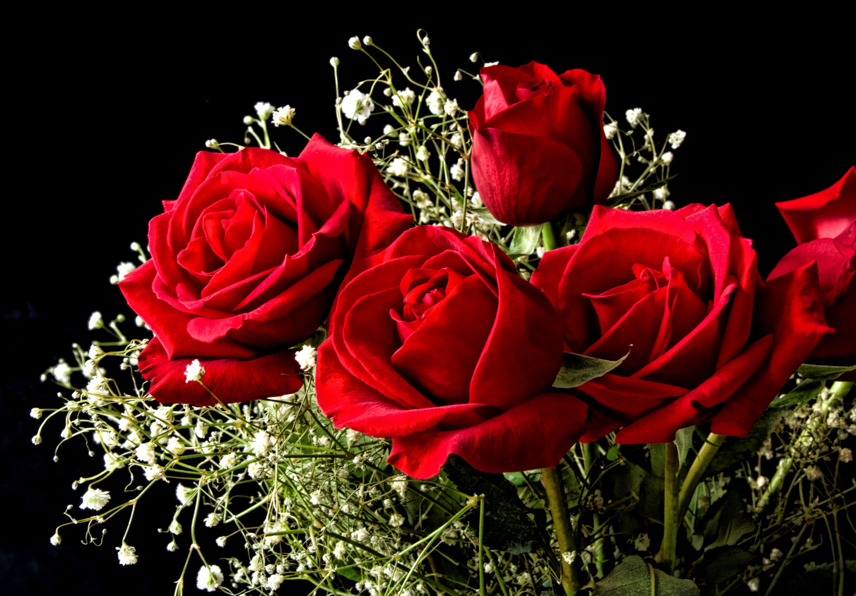
Thank You For Your Attention.
Have a nice future.

